Slide 1
THz Experiment

Slide 2
Initial Post Positions
Post1 = (11.00, 15.50)
Post2 = (9.50, 10.50)

Slide 3
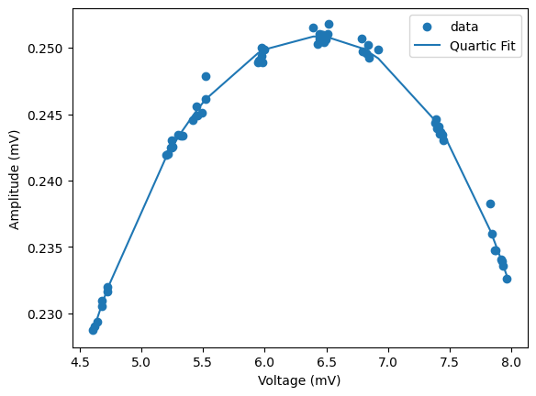
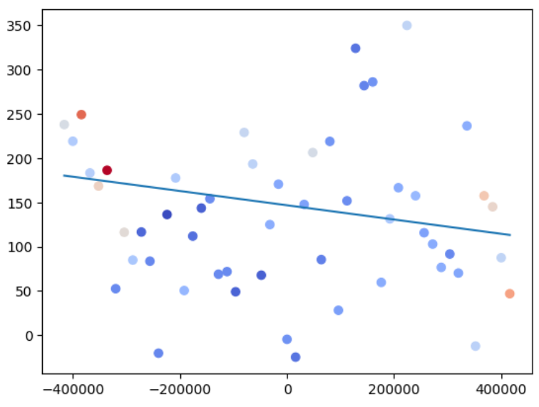
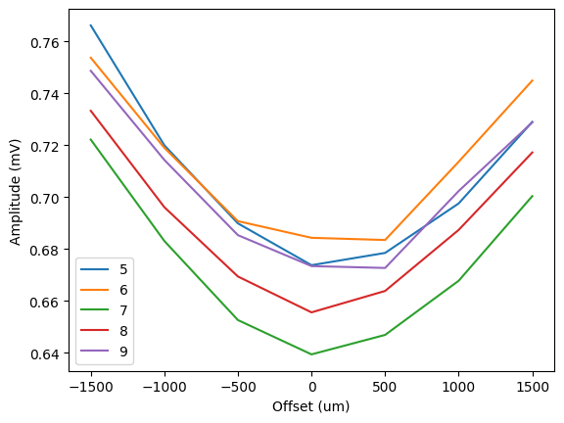
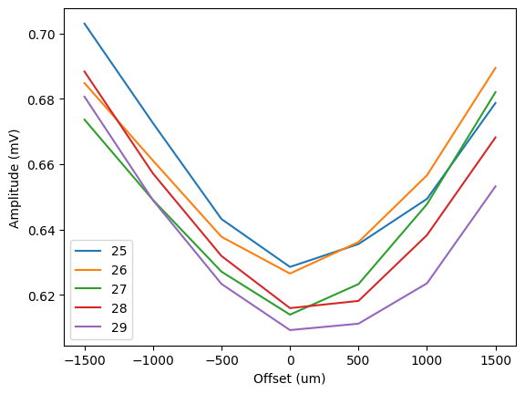
2023-05-31 X Traj vs Y offset
Good looking data
P1y adjustment: 0.300mm
P2y adjustment: 0.100mm

Slide 4
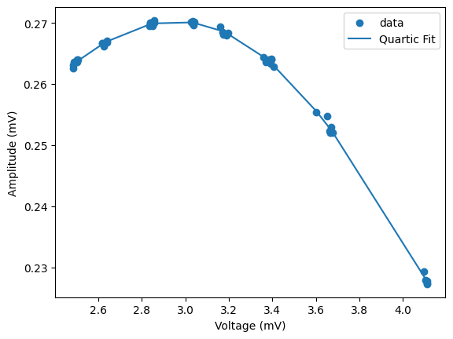
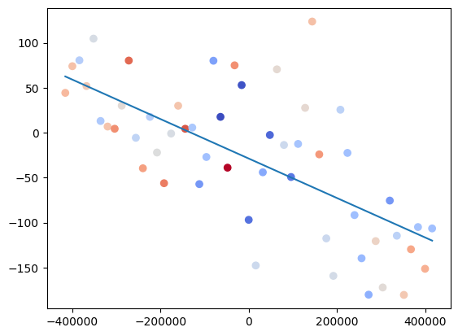
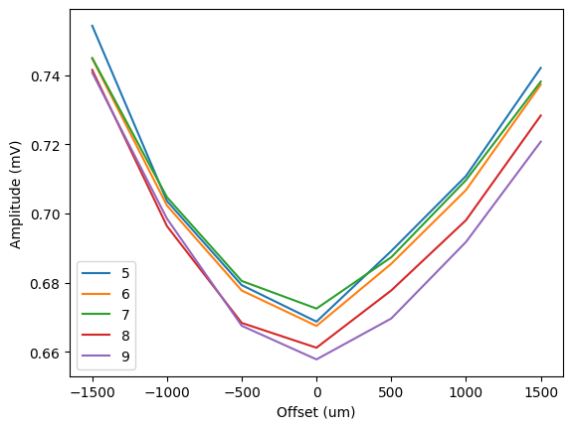
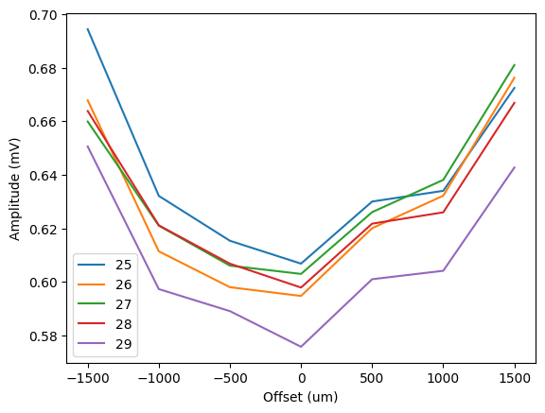
2023-06-01 Ytraj vs Xoffset
Not as nice looking father into undulator, but trajectory did get pretty wonky for +1000, +1500 offsets. Seems like a magnet was way too far in on one side.
P1x adjustment = 0.350mm
P2x adjustment = -0.200mm

Slide 5
Move Post Positions
Previous
Post1 = (11.00, 15.50)
Post2 = (9.50, 10.50)
Xadjust
P1x adjustment = 0.350mm
P2x adjustment = -0.200mm
Yadjust
P1y adjustment: 0.300mm
P2y adjustment: 0.100mm
New positions
Post1 = (11.35, 15.80)
Post2 = (9.30, 10.60)

Slide 6
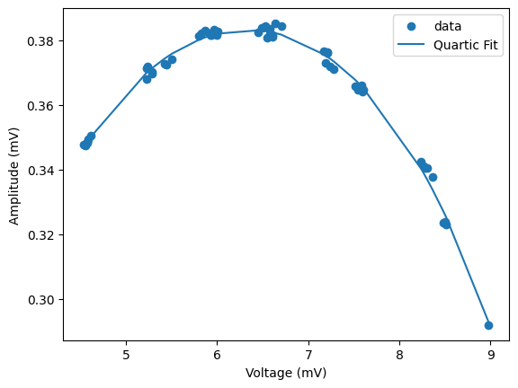
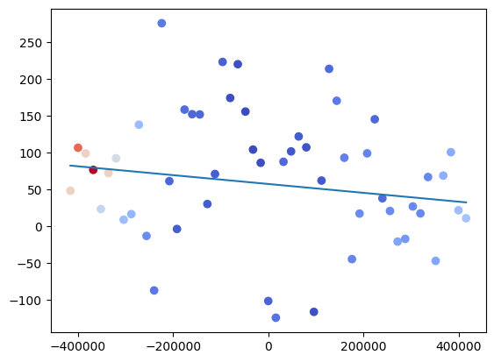
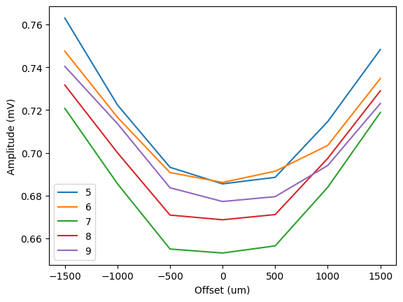
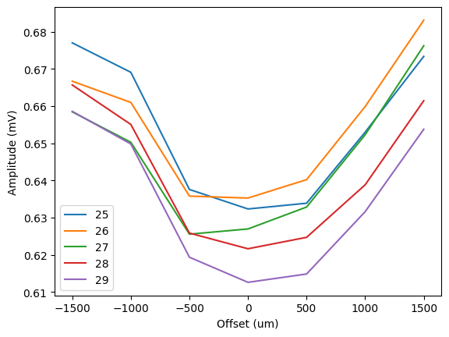
2023-06-05 Xtraj, Yoffset
Py1 adjustment = .150 mm
Py2 adjustment = .000 mm

Slide 7
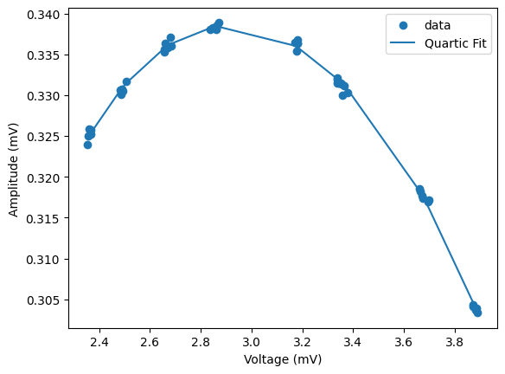
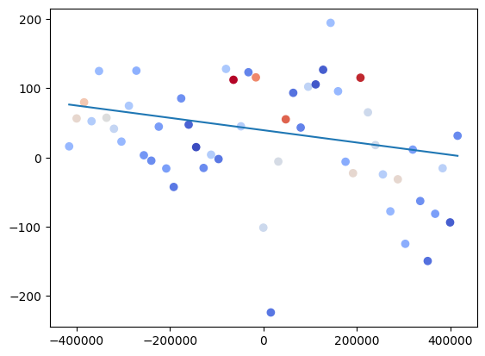
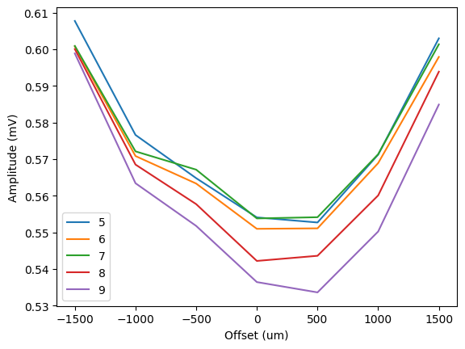
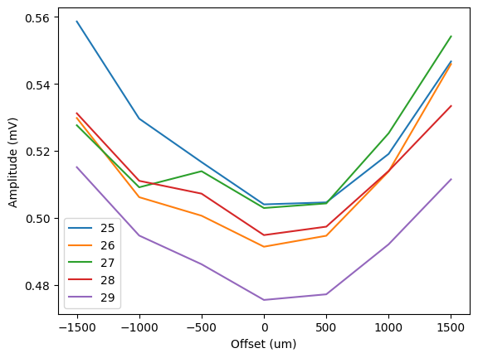
2023-06-05 ytraj, xoffset
Px1 adjustment = .150 mm
Px2 adjustment = .000 mm

Slide 8
Move Post Positions
Previous
Post1 = (11.35, 15.80)
Post2 = (9.30, 10.60)
Xadjust
P1x adjustment = 0.150mm
P2x adjustment = 0.000mm
Yadjust
P1y adjustment: 0.150mm
P2y adjustment: 0.000mm
Final positions
Post1 = (11.50, 15.95)
Post2 = (9.30, 10.60)

